Slide 1

MACHINE LEARNING -Steps
Start
Lyernisha S R
Lecturer, FICT

Slide 2
7 Steps of Machine Learning
Data Collection
Data Preparation
Choose a Model
Train the Model
Evaluate the Model
Parameter Tuning
Make Predictions

Slide 3
1 - Data Collection
The quantity & quality of your data dictate how accurate our model is
The outcome of this step is generally a representation of data which we will use for training
Using pre-collected data, by way of datasets from Kaggle, UCI, etc., still fits into this step
Mistakes such as choosing the incorrect features or focusing on limited types of entries for the data set may render the model completely ineffective.
That is why it is imperative that the necessary considerations are made when gathering data as the errors made in this stage would only amplify as we progress to latter stages.

Slide 4
2 - Data Preparation
Wrangle data and prepare it for training
Clean that which may require it (remove duplicates, correct errors, deal with missing values, normalization, data type conversions, etc.)
Randomize data, which erases the effects of the particular order in which we collected and/or otherwise prepared our data
Visualize data to help detect relevant relationships between variables or class imbalances (bias alert!), or perform other exploratory analysis
Another major component of data preparation is breaking down the data sets into 2 parts. The larger part (~80%) would be used for training the model while the smaller part (~20%) is used for evaluation purposes.
This is important because using the same data sets for both training and evaluation would not give a fair assessment of the model’s performance in real world scenarios.

Slide 5
3 - Choose a Model
Different algorithms are for different tasks; choose the right one
The selection of the model type is our next course of action once we are done with the data-centric steps.
There are various existing models developed by data scientists which can be used for different purposes.
These models are designed with different goals in mind.
For instance, some models are more suited to dealing with texts while another model may be better equipped to handle images.

Slide 6
4 - Train the Model
The heart of the machine learning process is the training of the model
The goal of training is to answer a question or make a prediction correctly as often as possible
Linear regression example: algorithm would need to learn values for m (or W) and b (x is input, y is output)
Each iteration of process is a training step
Training requires patience and experimentation.

Slide 7
5 - Evaluate the Model
Uses some metric or combination of metrics to "measure" objective performance of model
Test the model against previously unseen data
This unseen data is meant to be somewhat representative of model performance in the real world, but still helps tune the model
Good train/eval split? 80/20, 70/30, or similar, depending on domain, data availability, dataset particulars, etc.

Slide 8
6 - Parameter Tuning
This step refers to hyperparameter tuning
Tune model parameters for improved performance
Simple model hyperparameters may include : number of training steps, learning rate, initialization values and distribution, etc.

Slide 9
7 - Make Predictions
The final step of the machine learning process is prediction.
This is the stage where we consider the model to be ready for practical applications.
The model gains independence from human interference and draws its own conclusion on the basis of its data sets and training.
The challenge for the model remains whether it can outperform or at least match human judgment in different relevant scenarios.

Slide 10
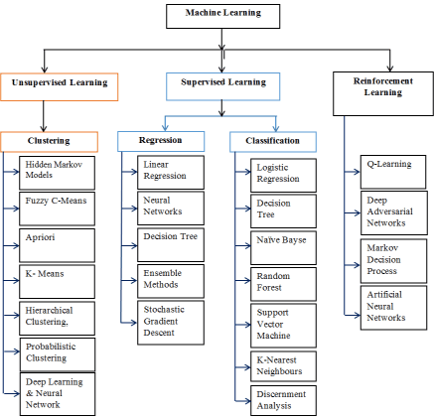
Machine learning classifiers

Slide 11
KNN Representation
The k-nearest neighbors (KNN) algorithm is a simple, supervised machine learning algorithm that can be used to solve both classification and regression problems.
It's easy to implement and understand but has a major drawback of becoming significantly slows as the size of that data in use grows.

Slide 12
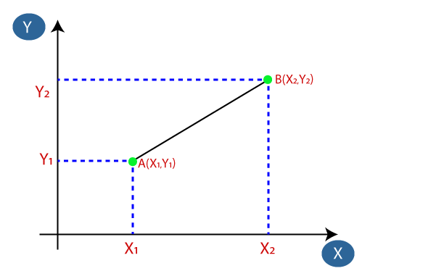
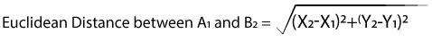
Finding the nearest neighbor

Slide 13
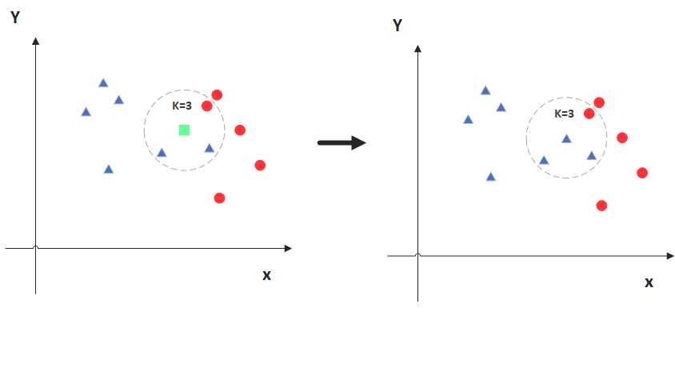
KNN CLASSIFICATION

Slide 14
Decision Trees
Decision Trees are a type of Supervised Machine Learning
The goal is to create a model that predicts the value of a target variable based on several input variables.
A decision tree is a tree-like graph with nodes representing the place where we pick an attribute and ask a question; edges represent the answers the to the question; and the leaves represent the actual output or class label.

Slide 15
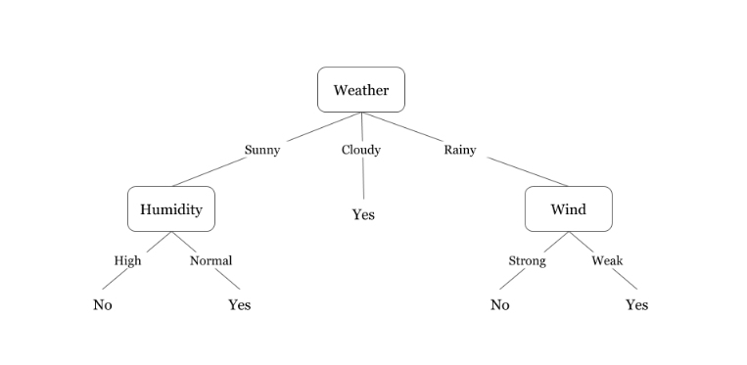
A decision tree for the concept play tennis/ badminton
Example: Assume we want to play badminton on a particular day ,say Saturday , how will you decide whether to play or not.
Factors to be considered: check if it's hot or cold, check the speed of the wind and humidity, how the weather is, i.e. is it sunny, cloudy, or rainy.
You have to take all these factors into account to reach a decision ie to Play Or Not.

Slide 16
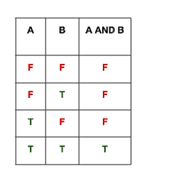
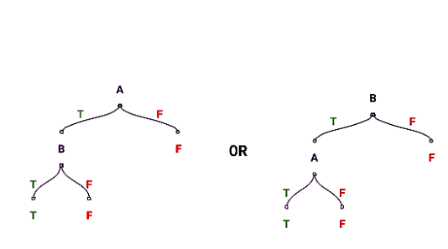
A decision tree for Boolean operations
AND OPERATION

Slide 17
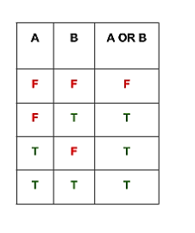
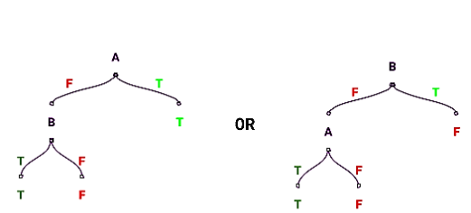
A decision tree for Boolean operations
OR OPERATION

Slide 18
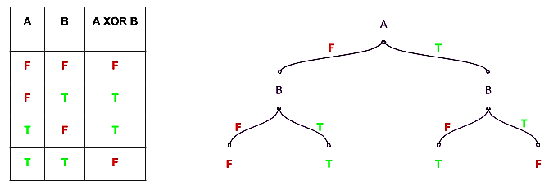
A decision tree for Boolean operations
XOR OPERATION

Slide 19
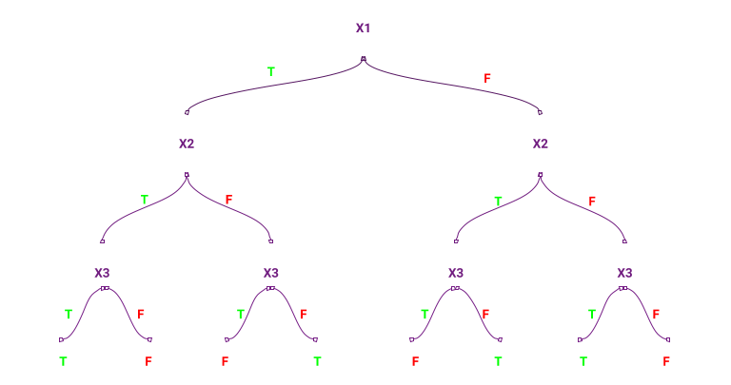
Activity
Draw a decision tree performing XOR functionality using 3 attributes X1, X2 ,X3

Slide 20
Summary
Seven steps in machine learning
Supervised learning methods- KNN algorithm, Decision trees
Thank you!

